Slide 1
Registry Forensics
COEN 152 / 252

Slide 2
Registry: A Wealth of Information
Information that can be recovered include:
  System Configuration
  Devices on the System
  User Names
  Personal Settings and Browser Preferences
  Web Browsing Activity
  Files Opened
  Programs Executed
  Passwords

Slide 3
Registry History
Before the Windows Registry: (DOS, Windows 3.x)
  INI files
    SYSTEM.INI – This file controlled all the hardware on the computer system.
    WIN.INI – This file controlled all the desktop and applications on the computer system.
Individual applications also utilized their own INI files that are linked to the WIN.INI.

Slide 4
Registry History: INI File Problems
Proliferation of INI files.
Other problems Size limitations
    Slow access
    No standards
    Fragmented
    Lack of network support

Slide 5
Registry History
The Windows 3.x OS also contained a file called REG.DAT.
The REG.DAT was utilized to store information about Object Link Embedding (OLE) objects.

Slide 6
Registry History
The Windows 9x/NT 3.5 Operating System is composed of the following files:
  System.dat – Utilized for system settings. (Win 9x/NT)
  User.dat – One profile for each use with unique settings specific to the user. (Win 9x/NT)
  Classes.dat – Utilized for program associations, context menus and file types. (Win Me only)
To provide redundancy, a back-up of the registry was made after each boot of the computer system. These files are identified as:
  System.dao (Win 95)
  User.dao (Win 95)
  Rbxxx.cab (Windows 98/Me)

Slide 7
Registry History
If there are numerous users on a computer system, the following issues arise:
  The User.dat file for each individual will be different as to the content.
  If all users on the computer system utilize the same profile, the information will all be mingled in the User.dat and will be difficult if not impossible to segregate the data.
  On Windows 9.x systems, the User.dat file for the default user is utilized to create the User.dat files for all new profiles.

Slide 8
Registry Definition
The Microsoft Computer Dictionary defines the registry as:
  A central hierarchical database used in the Microsoft Windows family of Operating Systems to store information necessary to configure the system for one or more users, applications and hardware devices.
  The registry contains information that Windows continually references during operation, such as profiles for each user, the applications installed on the computer and the types of documents that each can crate, property sheet settings for folders and application icons, what hardware exists on the system and the ports that are being sued.

Slide 9
Registry Definition
The registry was developed to overcome the restrictions of the INI and REG.DAT files.
The registry is composed of two pieces of information:
  System-Wide Information – This is data about software and hardware settings. This information tends to be apply to all users of the computer.
  User Specific Information – This is data about an individual configuration. This information is specific to a user’s profile.

Slide 10
Registry Organization
The Windows registry contains the following:
  Hives are utilized by the registry to store data on itself.
  Hives are stored in a variety of files that are dependent on the Windows Operating System that is being utilized.

Slide 11
Windows 9x Registry
Filename | Location | Content
system.dat | C:\Windows | Protected storage area for all users All installed programs and their settings System settings
user.dat If there are multiple user profiles, each user has an individual user.dat file in windows\profiles\user account | C:\Windows | Most Recently Used (MRU) files User preference settings

Slide 12
Windows XP Registry
Filename | Location | Content
ntuser.dat If there are multiple user profiles, each user has an individual user.dat file in windows\profiles\user account | \Documents and Settings\user account | Protected storage area for user Most Recently Used (MRU) files User preference settings
Default | \Windows\system32\config | System settings
SAM | \Windows\system32\config | User account management and security settings
Security | \Windows\system32\config | Security settings
Software | \Windows\system32\config | All installed programs and their settings
System | \Windows\system32\config | System settings

Slide 13
Registry Organization
Root Keys
  HKEY_CLASSES_ROOT (HKCR)
    Contains information in order that the correct program opens when executing a file with Windows Explorer.
  HKEY_CURRENT_USER (HKCU)
    Contains the profile (settings, etc) about the user that is logged in.
  HKEY_LOCAL_MACHINE (HKLM)
    Contains system-wide hardware settings and configuration information.
  HKEY_USERS (HKU)
    Contains the root of all user profiles that exist on the system.
  HKEY_CURRENT_CONFIG (HKCC)
    Contains information about the hardware profile used by the computer during start up.
Sub Keys – These are essentially sub directories that exist under the Root Keys.

Slide 14
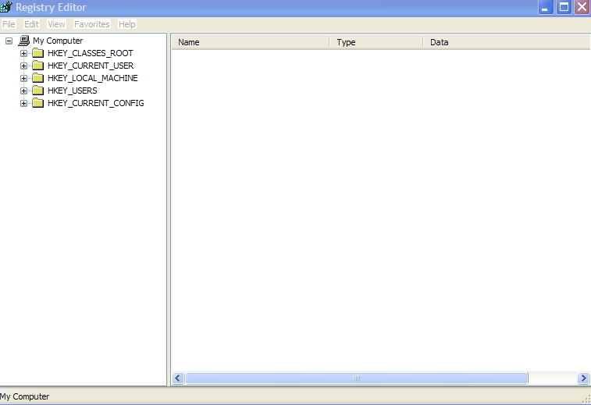
Registry Organization

Slide 15
Windows Security and Relative ID
The Windows Registry utilizes a alphanumeric combination to uniquely identify a security principal or security group.
The Security ID (SID) is used to identify the computer system.
The Relative ID (RID) is used to identity the specific user on the computer system.
The SID appears as:
  S-1-5-21-927890586-3685698554-67682326-1005

Slide 16
SID Examples
SID: S-1-0
Name: Null Authority
Description: An identifier authority.
  SID: S-1-0-0
  Name: Nobody
  Description: No security principal.
  SID: S-1-1
  Name: World Authority
  Description: An identifier authority.
  SID: S-1-1-0
  Name: Everyone
  Description: A group that includes all users, even anonymous users and guests. Membership is controlled by the operating system.
  SID: S-1-2
  Name: Local Authority
  Description: An identifier authority.
  SID: S-1-3
  Name: Creator Authority
  Description: An identifier authority.

Slide 17
SID
Security ID
  NT/2000/XP/2003
    HKLM>SAM>Domains>Accounts>Aliases>Members
      This key will provide information on the computer identifier
    HKLM>SAM>Domains>Users
      This key will provide information in hexadecimal
    User ID
      Administrator – 500
      Guest – 501
    Global Groups ID
      Administrators – 512
      Users – 513
      Guest - 514

Slide 18
MRU
To identify the Most Recently Used (MRU) files on a suspect computer system:
  Windows 9x/Me
    User.dat
      Search should be made for MRU, LRU, Recent
  Windows NT/2000
    Ntuser.dat
      Search should be made for MRU, LRU, Recent
  Windows XP/2003
    HKU>UserSID>Software>Microsoft>Windows>
    CurrentVersion>Explorer>RecentDoc
    Select file extension and select item

Slide 19
Registry Forensics
Registry keys have last modified time-stamp
  Stored as FILETIME structure
    like MAC for files
  Not accessible through reg-edit
  Accessible in binary.

Slide 20
Registry Forensics
Registry Analysis:
  Perform a GUI-based live-system analysis.
    Easiest, but most likely to incur changes.
    Use regedit.
  Perform a command-line live-system analysis
    Less risky
    Use “reg” command.
  Remote live system analysis
    regedit allows access to a remote registry
    Superscan from Foundstone
  Offline analysis on registry files.
    Encase, FTK (Access data) have specialized tools
    regedit on registry dump.

Slide 21
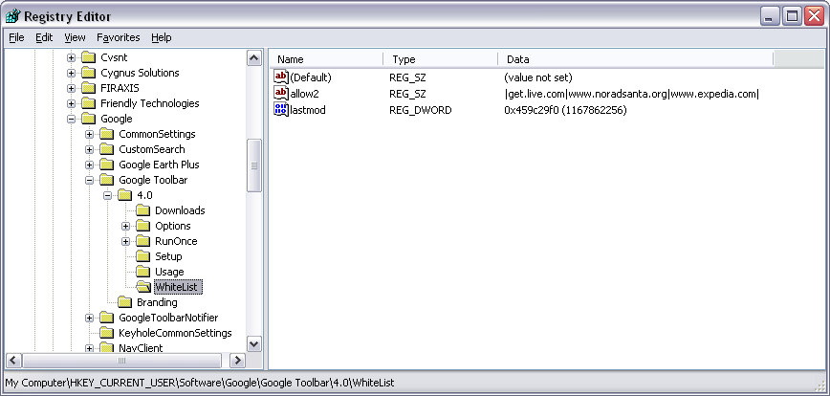
Registry Forensics
Websites

Slide 22
Registry Forensics: NTUSER.DAT
AOL Instant Messenger Away messages
  File Transfer & Sharing
  Last User
  Profile Info
  Recent Contacts
  Registered Users
  Saved Buddy List

Slide 23
Registry Forensics: NTUSER.DAT
ICQ
  IM contacts, file transfer info etc.
  User Identification Number
  Last logged in user
  Nickname of user

Slide 24
Registry Forensics: NTUSER.DAT
Internet Explorer
  IE auto logon and password
  IE search terms
  IE settings
  Typed URLs
  Auto-complete passwords

Slide 25
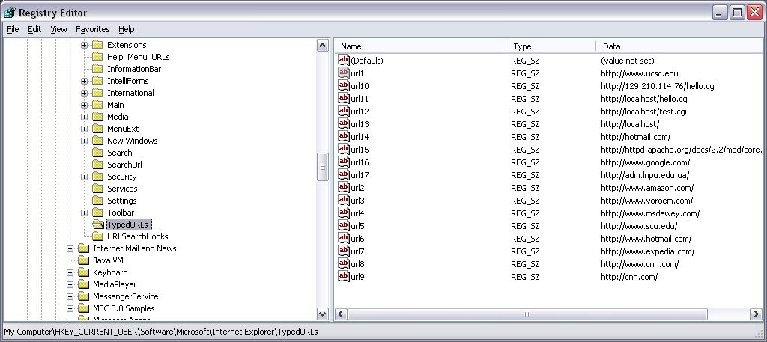
Registry Forensics: NTUSER.DAT
IE explorer Typed URLs

Slide 26
Registry Forensics: NTUSER.DAT
MSN Messenger
  IM groups, contacts, …
  Location of message history files
  Location of saved contact list files

Slide 27
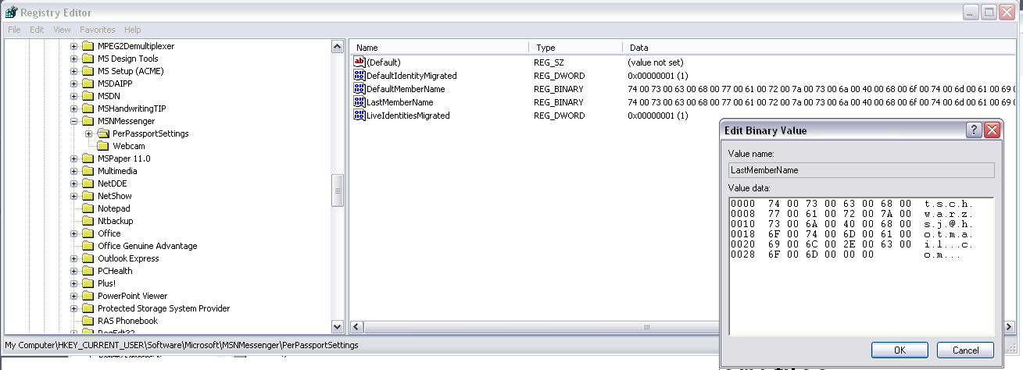
Registry Forensics: NTUSER.DAT
Last member name in MSN messenger

Slide 28
Registry Forensics: NTUSER.DAT
Outlook express account passwords

Slide 29
Registry Forensics
Yahoo messenger
  Chat rooms
  Alternate user identities
  Last logged in user
  Encrypted password
  Recent contacts
  Registered screen names

Slide 30
Registry Forensics
System:
  Computer name
  Dynamic disks
  Install dates
  Last user logged in
  Mounted devices
  Windows OS product key
  Registered owner
  Programs run automatically
  System’s USB devices

Slide 31
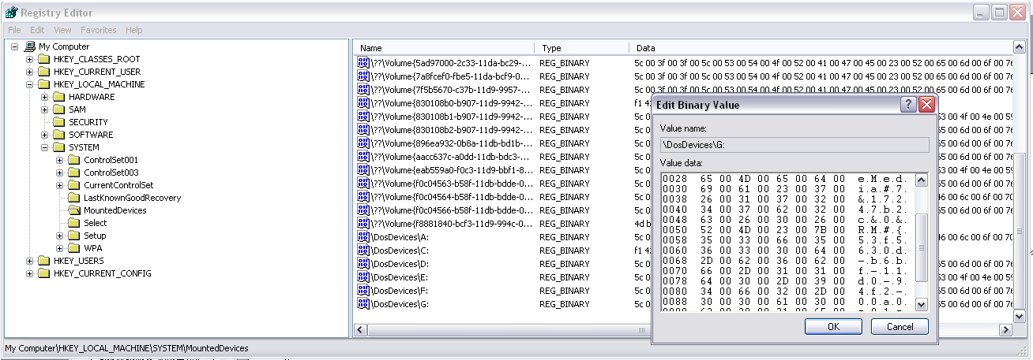
Registry Forensics

Slide 32
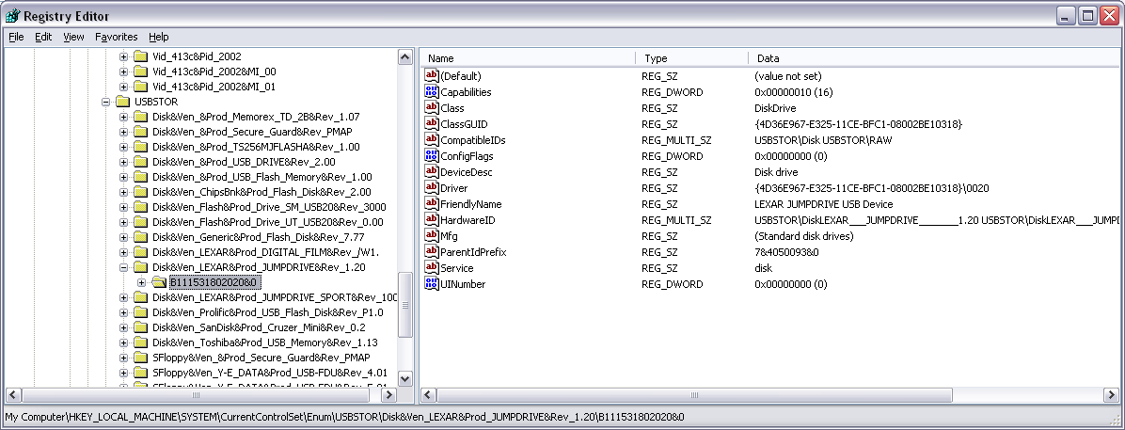
Registry Forensics
USB Devices

Slide 33
Registry Forensics
Networking
  Local groups
  Local users
  Map network drive MRU
  Printers

Slide 34
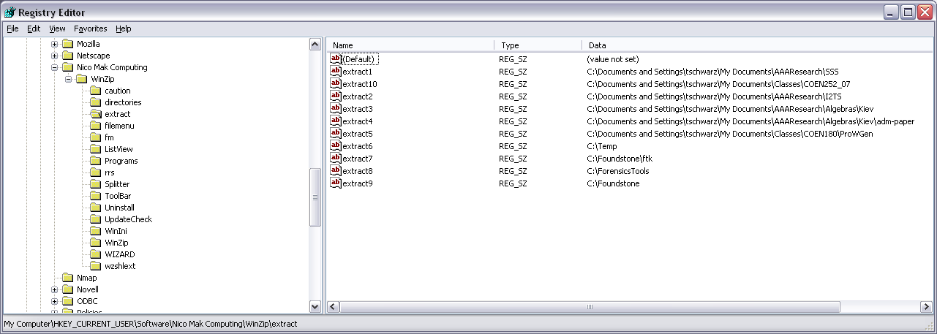
Registry Forensics
Winzip

Slide 35
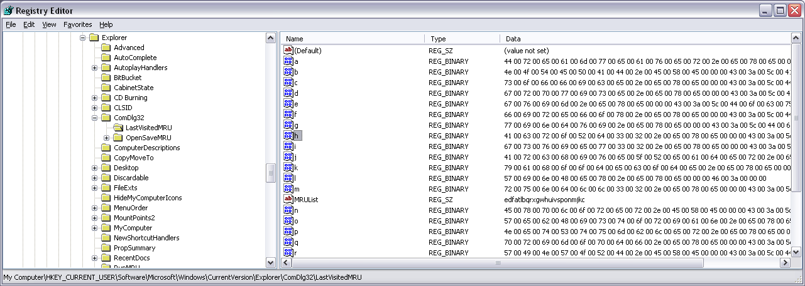
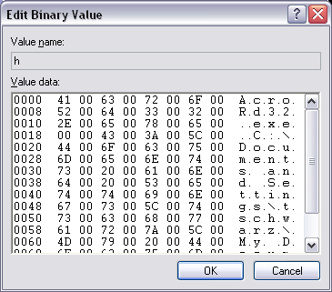
Registry Forensics
List of applications and filenames of the most recent files opened in windows

Slide 36
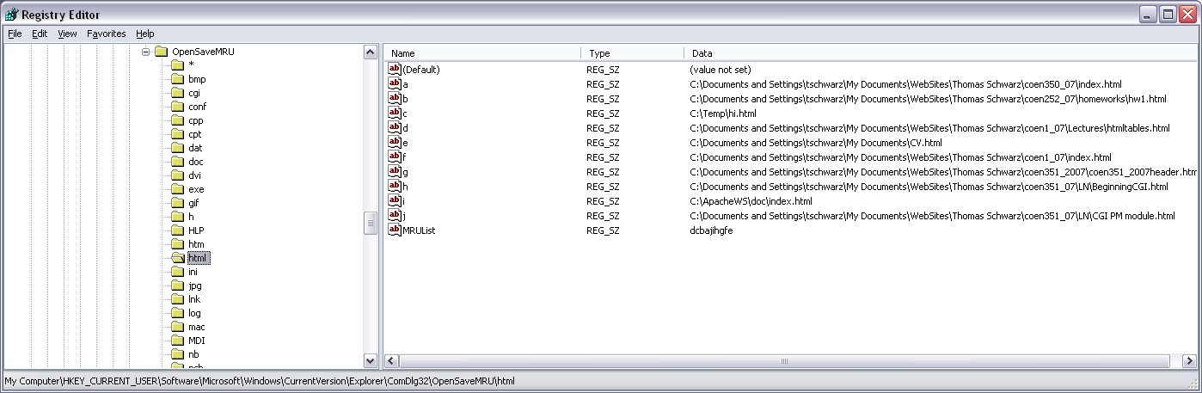
Registry Forensics
Most recent saved (or copied) files

Slide 37
Registry Forensics
System
  Recent documents
  Recent commands entered in Windows run box
  Programs that run automatically
    Startup software
    Good place to look for Trojans

Slide 38
Registry Forensics
User Application Data
  Adobe products
  IM contacts
  Search terms in google
  Kazaa data
  Windows media player data
  Word recent docs and user info
  Access, Excel, Outlook, Powerpoint recent files

Slide 39
Registry Forensics
Go to
  Access Data’s Registry Quick Find Chart

Slide 40
Registry Forensics
Case Study
  (Chad Steel: Windows Forensics, Wiley)
  Department manager alleges that individual copied confidential information on DVD.
  No DVD burner was issued or found.
  Laptop was analyzed.
  Found USB device entry in registry:
  PLEXTOR DVDR PX-708A
  Found software key for Nero - Burning ROM in registry
  Therefore, looked for and found Nero compilation files (.nrc). Found other compilation files, including ISO image files.
  Image files contained DVD-format and AVI format versions of copyrighted movies.
  Conclusion: No evidence that company information was burned to disk. However, laptop was used to burn copyrighted material and employee had lied.

Slide 41
Registry Forensics
Intelliform:
  Autocomplete feature for fast form filling
  Uses values stored in the registry
    HKEY_CURRENT_USER\Software\Microsoft\Protected Storage System Provider
    Only visible to SYSTEM account
  Accessible with tools such as Windows Secret Explorer.

Slide 42
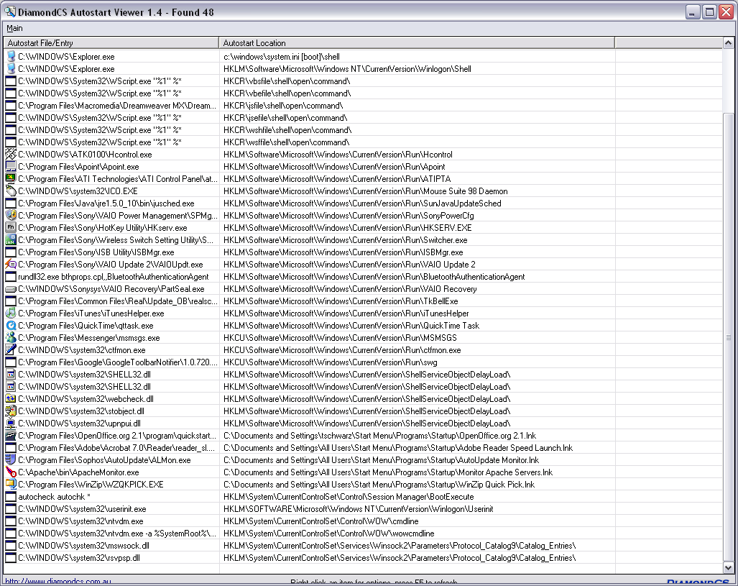
Registry Forensics:
AutoStart Viewer (DiamondCS)

Slide 43
Registry Research
Use REGMON (MS Sysinternals) to monitor changes to the registry
  Registry is accessed constantly
    Need to set filter
    Or enable Regmon’s log boot record
      Captures registry activity in a regmon file
Do it yourself: Windows API
  RegNotifyChangeKeyValue
Many commercial products
  DiamondCS RegProt
    Intercepts changes to the registry

Slide 44
Registry Forensics Investigation
Forensics tools allow registry investigation from image of drive
Differences between life and offline view
  No HARDWARE hive (HKLM)
    Dynamic key, created at boot
  No virtual keys such as HKEY_CURRENT_USER
    Derived from SID key under HKEY_USERS
    Source file is NTUSER.DAT
  Do not confuse current and repair versions of registry files
    %SystemRoot%\system32\config (TRUE registry)
    %SystemRoot%\repair (repair version of registry)

Slide 45
Registry Forensics Investigation
Forensics search can reveal backups of registry
  Intruders leave these behind when resetting registry in order not to damage system

Slide 46
Registry Forensics Investigation
Time is Universal Time Coordinated
  a.k.a. Zulu
  a.k.a Greenwhich Time

Slide 47
Registry Forensics Investigation
Software Key
  Installed Software
    Registry keys are usually created with installation
    But not deleted when program is uninstalled
    Find them
      Root of the software key
        Beware of bogus names
      HKEY_LOCAL_MACHINE\SOFTWARE\Microsoft\Windows\CurrentVersion\App Paths
      HKEY_LOCAL_MACHINE\SOFTWARE\Microsoft\Windows\CurrentVersion\Uninstall
    If suspicious, use information from the registry to find the actual code
    Registry time stamps will confirm the file MAC data or show them to be altered

Slide 48
Registry Forensics Investigation
Software Key
  Last Logon
    HKEY_LOCAL_MACHINE\SOFTWARE\Microsoft\Windows NT\CurrentVersion\WinLogon
  Logon Banner Text / Legal Notice
    HKEY_LOCAL_MACHINE\SOFTWARE\Microsoft\Windows NT\CurrentVersion\WinLogon
  Security Center Settings
    HKEY_LOCAL_MACHINE\SOFTWARE\Microsoft\Security Center
    HKEY_LOCAL_MACHINE\SYSTEM\CurrentControlSet\Services\SharedAccess\Parameters\FirewallPolicy
      If firewall logging is enabled, the log is typically at %SystemRoot%/pfirewall.log

Slide 49
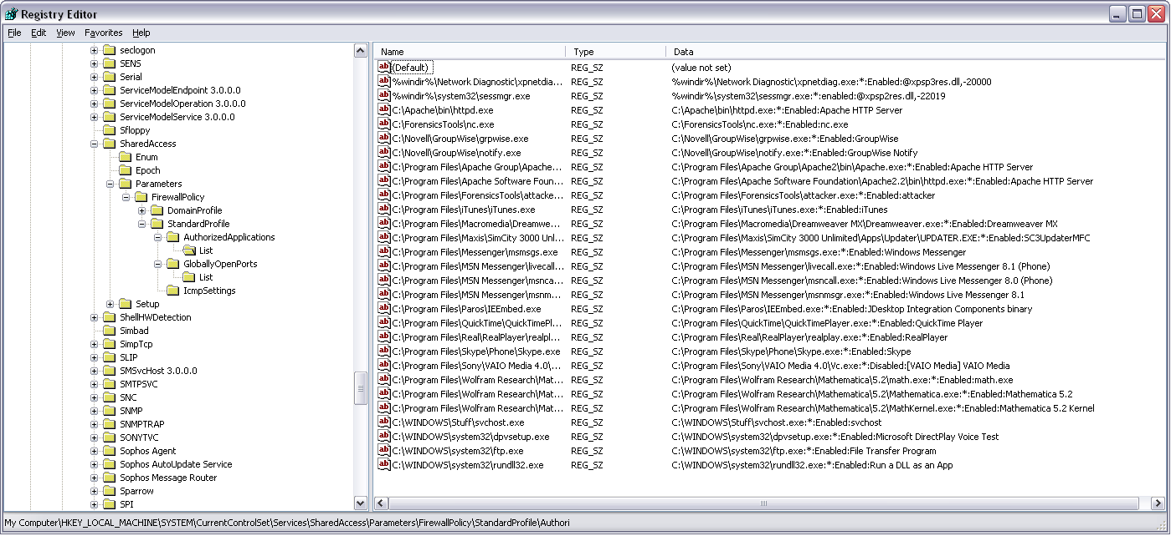
Registry Forensics Investigation

Slide 50
Registry Forensics Investigation
Analyze Restore Point Settings
  Restore points developed for Win ME / XP
  Restore point settings at
    HKEY_LOCAL_MACHINE\SOFTWARE\Microsoft\Windows NT\CurrentVersion\SystemRestore
  Restore points created every RPGlobalInterval value seconds (~every 24h)
  Retention period is RPLifeInterval seconds (default 90 days)
  Restore point taking in ON by default
  Restore points in System Volume Information\restore…

Slide 51
Registry Forensics Investigation
Aside: How to access restore points
  Restore points are protected from user, including administrator
  Administrator can add her/himself to the access list of the system volume directory
    Turn off “Use simple file sharing” in Control Panel → Folder Options
    Click on “Properties” of the directory in Explorer and

Slide 52
Registry Forensics Investigation
Restore point
  makes copies of important system and program files that were added since the last restore points
    Files
      Stored in root of RP### folder
      Names have changed
      File extension is unchanged
      Name changes kept in change.log file
    Registry data
      in Snapshot folder
      Names have changed, but predictably so

Slide 53
Registry Forensics Investigation
SID (security identifier)
  Well-known SIDs
    SID: S-1-0 Name: Null Authority
    SID: S-1-5-2 Name: Network
  S-1-5-21-2553256115-2633344321-4076599324-1006
    S string is SID
    1 revision number
    5 authority level (from 0 to 5)
    21-2553256115-2633344321-4076599324 domain or local computer identifier
    1006 RID – Relative identifier
Local SAM resolves SID for locally authenticated users (not domain users)
  Use recycle bin to check for owners

Slide 54
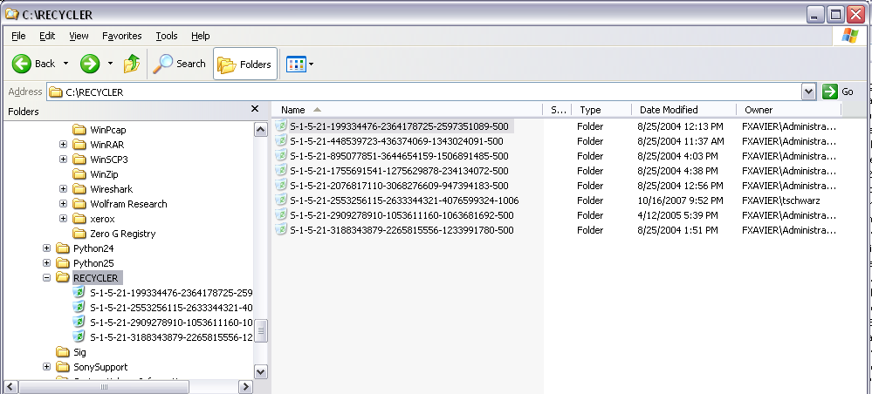
Registry Forensics Investigation
Resolving local SIDs through the Recycle Bin
(life view)

Slide 55
Registry Forensics Investigation
Protected Storage System Provider data
  Located in NTUSER.DAT\Software\Microsoft\ Protected Storage System Provider
  Various tools will reveal contents
    Forensically, AccessData Registry Viewer
    Secret Explorer
    Cain & Abel
    Protected Storage PassView v1.63

Slide 56
Registry Forensics Investigation
MRU: Most Recently Used
  HKEY_CURRENT_USER\SOFTWARE\Microsoft\Windows\CurrentVersion\Exlorer\RunMRU
  HKEY_CURRENT_USER\SOFTWARE\Microsoft\Windows\CurrentVersion\Exlorer\Map Network Drive MRU
  HKEY_CURRENT_USER\Printers\Settings\Wizard\ConnectMRU
  HKEY_CURRENT_USER\SOFTWARE\Microsoft\Windows\CurrentVersion\Exlorer\ComDlg32
    Programs and files opened by them
    Files opened and saved
  HKEY_CURRENT_USER\SOFTWARE\Microsoft\Search Assistant\ACMru

Slide 57
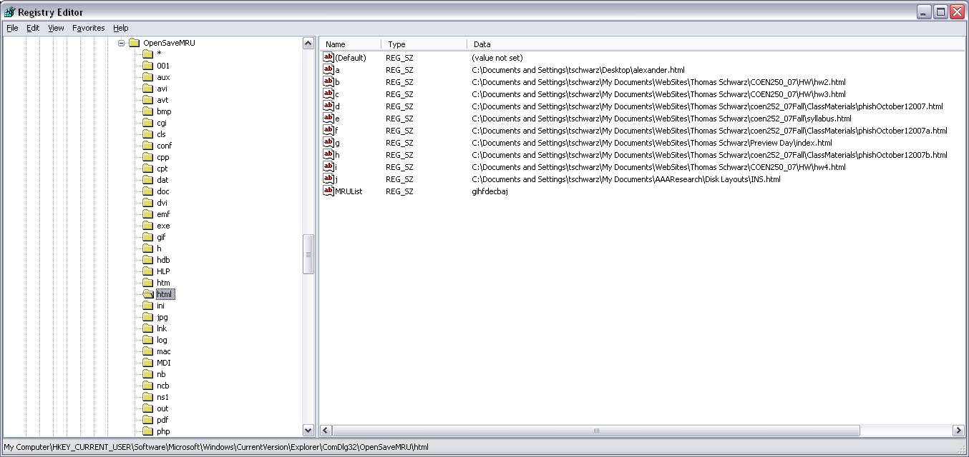
Registry Forensics Investigation

Slide 58
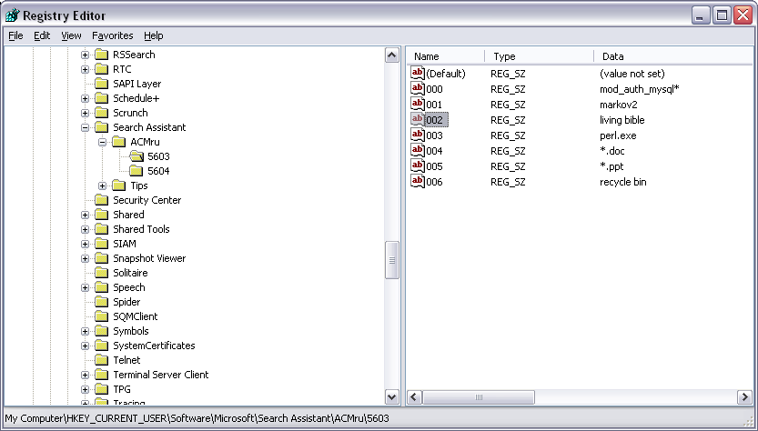
Registry Forensics Investigation

Slide 59
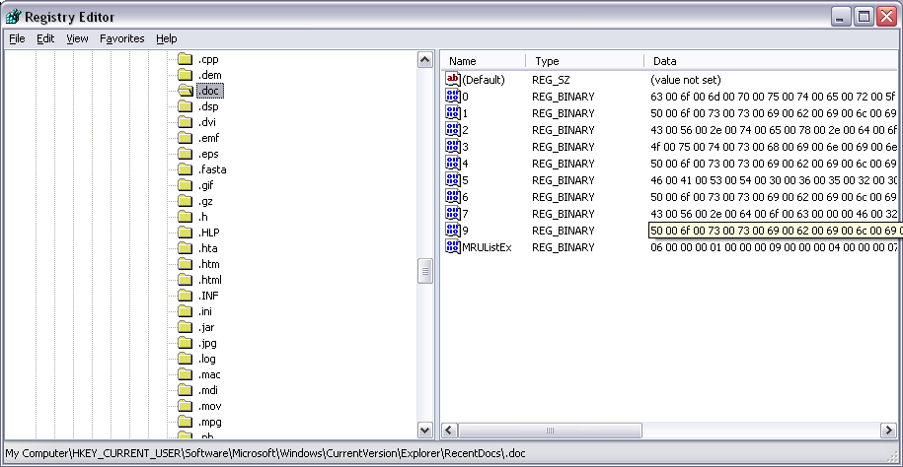
Registry Forensics Investigation

Slide 60
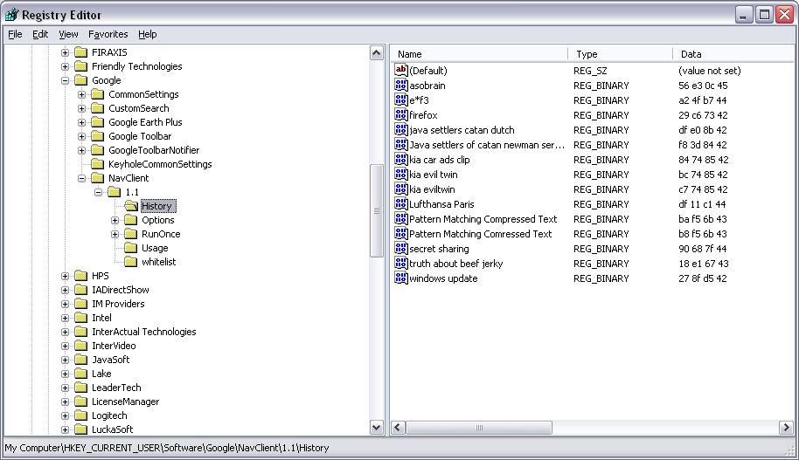
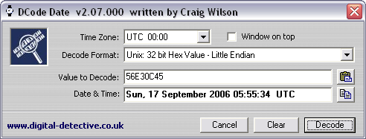
Registry Forensics Investigation

Slide 61
Registry Forensics Investigation
HKEY_CURRENT_USER\SOFTWARE\Microsoft\Windows\CurrentVersion\Exlorer\UserAssist\{*********}\Count
  ROT-13 encoding of data used to populate the User Assist Area of the start button
    Contains most recently used programs

Slide 62
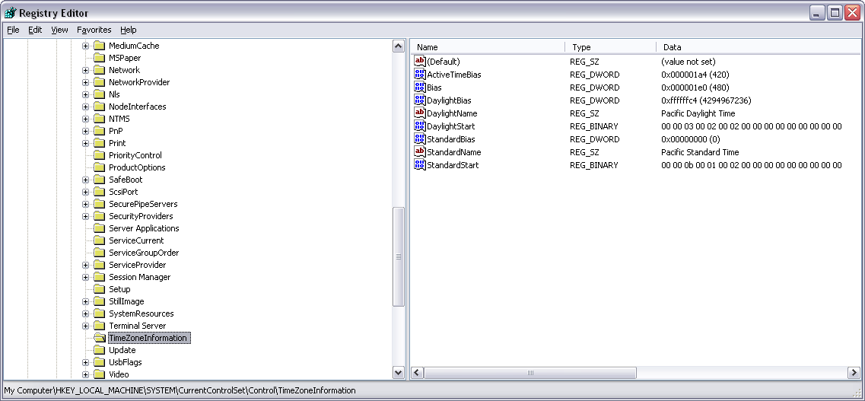
Registry Forensics Investigation

Slide 63
Registry Forensics Investigation
AutoRun Programs
  Long list of locations in registry
  Long list of locations outside the registry
    SystemDrive\autoexec.bat
    SystemDrive\config.exe
    Windir\wininit.ini
    Windir\winstart.bat
    Windir\win.ini
    Windir\system.ini
    Windir\dosstart.bat
    Windir\system\autoexec.nt
    Windir\system\config.nt
    Windir\system32\autochk.exe

Slide 64
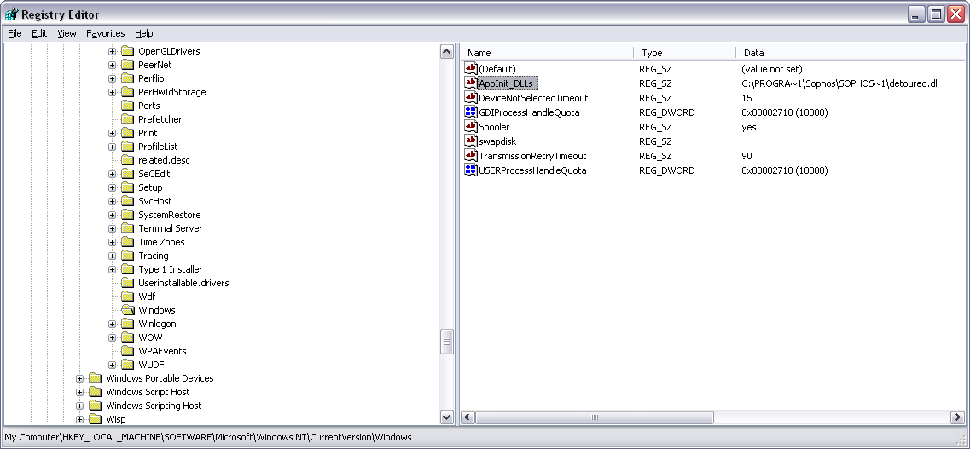
Registry Forensics Investigation
Rootkit Enabler
  Attacker can use AppInit_DLL key to run own DLL.

